Slide 1
Module 2
Root Cause Analysis and Turning Crisis into Opportunity

Slide 2
Chapter 21
The Role of Root Cause Analysis In Public Safety ERM Programs

Slide 3
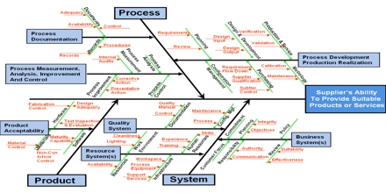
Notes:
Root cause is best applied when a serious problem or losses have been found and incurred – pg 397
Root cause analysis is used to determine why the risks occurred and future knowledge of preventing those risks to occur again – pg 398
Root Cause Analysis has general tools to determine the why and prevent the risks from future occurrence
Five Why’s Analysis – 5 levels of successive why questions to deeply mine causality
Very good for single obstacle that needs a deep drill down within an unbranched chain of events – pg 398
Limitations on subjectivity and only provides information known by the provider – pg 399
Cause and Effect Analysis
FMECA – Failure Mode, Effects, and Criticality Analysis
Force Field Analysis

Slide 4
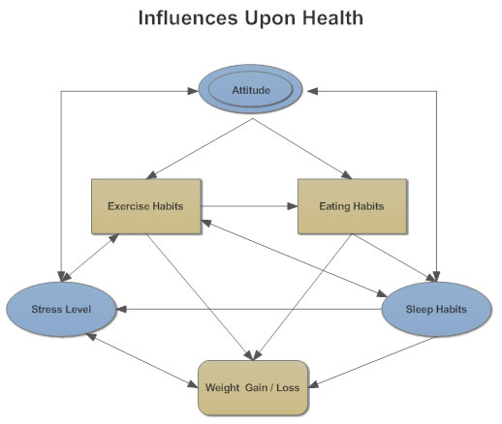
Notes:
Influence Diagrams
Graphically identify forces that either help or hinder a particular initiative – pg 411
Can be used from the standpoint of a community problem where social forces will either help or obstruct a specific solution to a problem – pg 412
Two techniques – pg412
Issues based
Personality based
Add key personality influencers within diagram to assist with overview – pg 412
Concept Fans
A loosely related form of root cause analysis – pg 413
Used to organize the outputs of the other root cause analysis into a whole diagrammatic overall view point – pg 414
Used to also examine the risks that surround a strategic objective or goal to the problem – pg 415

Slide 5
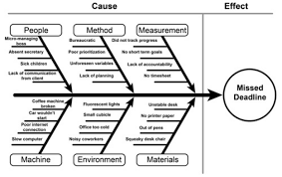
Notes:
Root Cause Analysis for the increase in homicides within Old City
Consideration of examining the lead-up of violent incidents before the homicides – pg 417
Consideration of the pressures of the indigent, oil bust/boom mentality and reality. – pg 417
Cause and Effect, FMECA, Force Field Analysis, Influence Diagrams, and Concept Fans used in the risk analysis – pg 417
Five why’s were too narrow to use for such a large problem – pg 417
Focus on the causes of root safety to the residents pg 424
Develop strategies and partnerships within the community to address root causes far before homicides take place – pg424
Application of resources are better placed to the root cause instead of reactive measures – pg 424

Slide 6
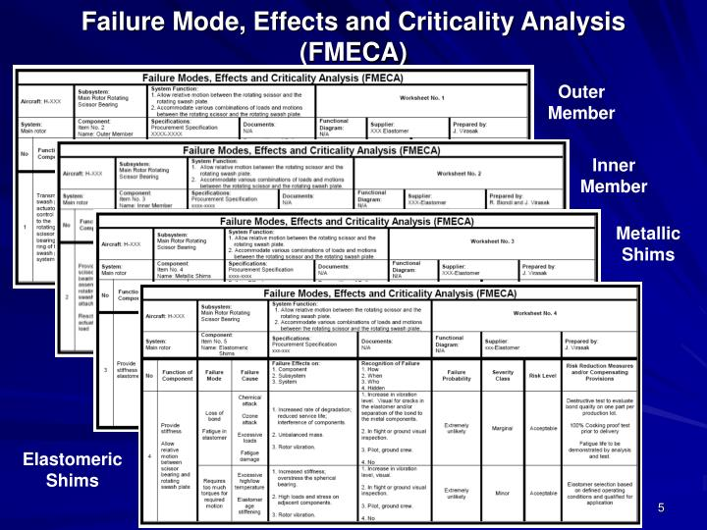
FMECA Analysis Example
https://www.bing.com/images/search?view=detailV2&ccid=2iUsza1X&id=BC4CB4BDE256E59BF092AE649204CF21CDD0E3CF&thid=OIP.2iUsza1XE6GvlIN96h2zYgEgDY&mediaurl=http%3a%2f%2fimage1.slideserve.com%2f3364452%2ffailure-mode-effects-and-criticality-analysis-fmeca-n.jpg&exph=540&expw=720&q=ERM+failure+mode%2c+effects%2c+and+criticality+analysis&simid=608034562009007650&selectedIndex=1&ajaxhist=0

Slide 7
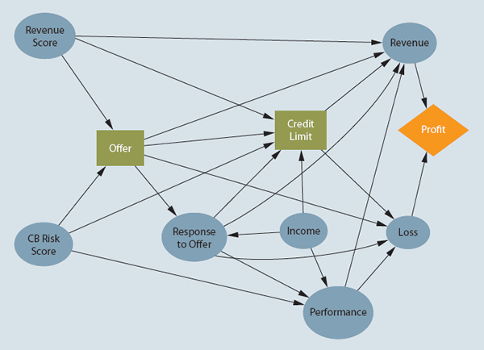
ERM Influence Diagram Example
https://www.bing.com/images/search?view=detailV2&ccid=1X5kpJ%2bS&id=25917D2E34BF8AC6D2168031E9657102BA3BCD68&thid=OIP.1X5kpJ-SACnZ5WMvUtYgsAEsDZ&mediaurl=http%3a%2f%2fwww.fico.com%2fen%2fsites%2fdefault%2ffiles%2ffigure11page40.jpg&exph=434&expw=600&q=ERM+Influence+diagrams&simid=608029850415467733&selectedIndex=8&ajaxhist=0

Slide 8
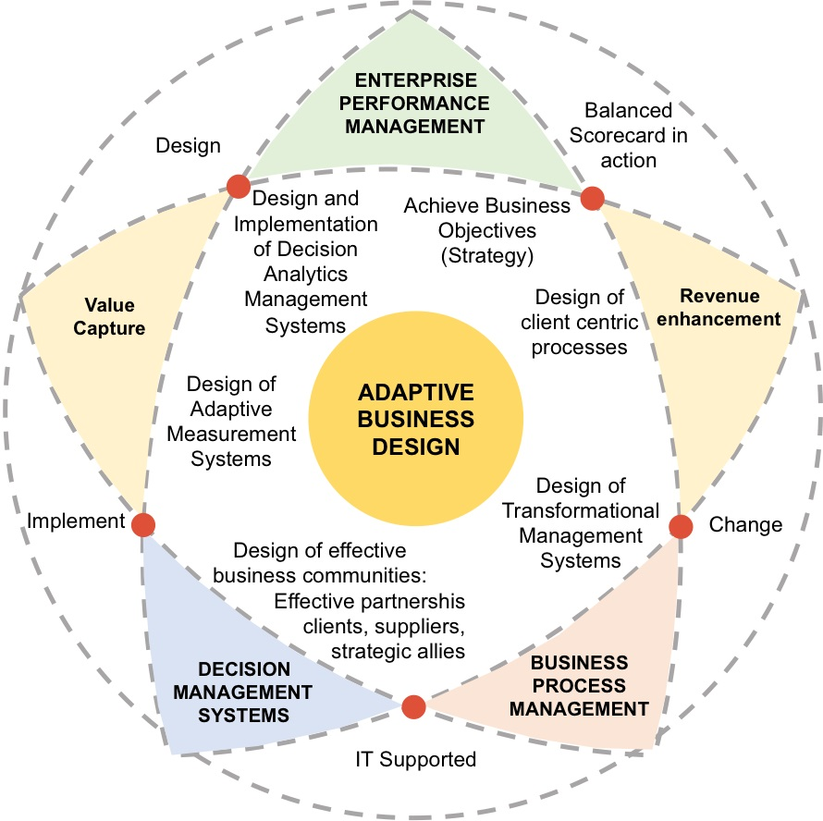
ERM Concept Fan - Example
https://www.bing.com/images/search?view=detailV2&ccid=6JLxS29q&id=D45E5FA332ECB746C6076273B8BFA3FA1260A6A2&thid=OIP.6JLxS29qj0Omc8FLVRzI3wEsEr&mediaurl=http%3a%2f%2fwww.enterprise-concept.com%2fwp-content%2fuploads%2f2015%2f05%2fschema-mare.jpg&exph=888&expw=890&q=enterprise+risk+management+concept+fan&simid=607999759922235587&selectedIndex=11&ajaxhist=0

Slide 9
Chapter 34
Turning Crisis into Opportunity: Building an ERM Program at General Motors

Slide 10
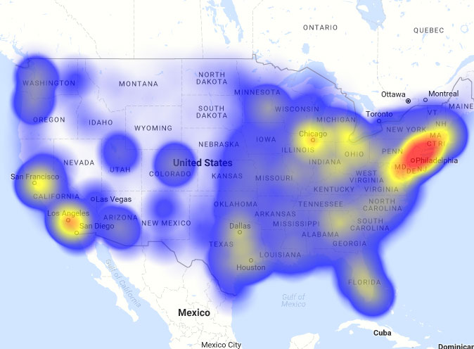
Notes:
Initial implementation was to focus on a bottom up approach to ERM
The GM goal was to achieve multiple views from sources outside the company to gain an outside of the woods viewpoint – pg 609
Heat mapping sessions were held throughout the organization to organize risks based on probability and impact – pg 610
Moved to a three tiered approach to ranking risks for greater efficiency and understanding – pg 611
Tier 1 Top risks closely followed and partnered to board/committees
Tier 2 Complete risk templates and send to Committee at least annually
Tier 3 – Watch list. Corporate templates monitored by Risk Officer & Senior Executive Owner
Workshops focus on answering – pg 616
Who else can affect the outcome? (Players)
What can BM and others do? (Options)
What do GM and the other players want? (Preferences)

Slide 11
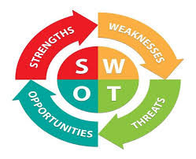
Notes:
Game theory used at GM - pg 617
Team puts themselves into the shoes of each player and ask whether they want each option to be taken and how important that option is relative to others on the list
Assists GM in identifying a natural outcome
Assists GM in identifying a target outcome
War gaming workshops – pg 618
Start with the known SWOT of key players
Key players within the workshop put themselves into the competitors shoes and work through what that specific competitor would want the outcome to occur based upon their own SWOT
GM developed a operational control self assessment (CSA) that assists in the operational day to day risk controls – pg 619
Used in conjunction with internal audit to ensure financial aspects of risk are included

Slide 12
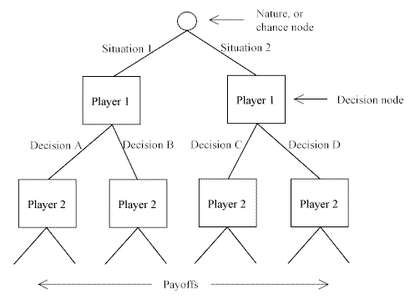
Game Theory Diagram Example
https://www.bing.com/images/search?view=detailV2&ccid=NUnf2dRX&id=B5ECCD7485B172EC8980B22D6A35334C16EAD3B4&thid=OIP.NUnf2dRXReQbKUUNih-ZyAEsDb&mediaurl=http%3a%2f%2fwww.quickmba.com%2fimages%2fecon%2fmicro%2fgametheory%2fextensiveform.gif&exph=359&expw=491&q=Game+Theory+Diagram&simid=608031383759291308&selectedIndex=1&ajaxhist=0

Slide 13
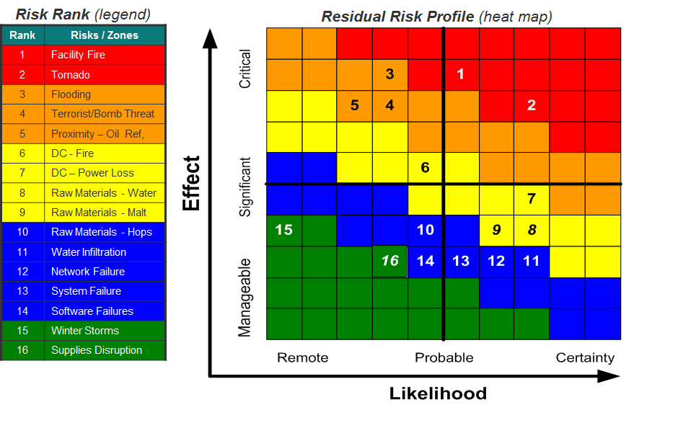
Heat Map Example
https://www.bing.com/images/search?view=detailV2&ccid=lnCLVg7w&id=9A4005181A26CBF7740B825DACAAAAD5CFCA078D&thid=OIP.lnCLVg7woDuRu08tWAVRcQEsDF&mediaurl=http%3a%2f%2fwww.cleanri.com%2fpostpic%2f2013%2f12%2frisk-heat-map-chart_569525.png&exph=619&expw=940&q=ERM+Heat+Map&simid=607996070539102776&selectedIndex=12&ajaxhist=0

Slide 14
References
John R.S. Fraser, B. J. (2015). Implementing Enterprise Risk Management. New Jersey: Wiley & Son, Inc.,

